Slide 1
Subject: Electricity Laboratory
Experiement 4: Charge and Discharge of a Capacitor
Al-Karkh University of Science
College of Science
Department of Medical Physics
Prepared by:
Dr. Nihad K Ali
Zaineb Faleh Nazal

Slide 2
Charge and Discharge of a Capacitor
Introduction
Capacitors are devices that can store electric charge and energy. Capacitors have several uses, such as _lters in DC power supplies and as energy storage banks for pulsed lasers. Capacitors pass AC current, but not DC current, so they are used to block the DC component of a signal so that the AC component can be measured. A capacitor can be slowly charged to the necessary voltage and then discharged quickly to provide the energy needed.

Slide 3
Objective of the experiment:
Learn about capacitor charging and discharging.
Calculate the time constant for the capacitor discharge.
Calculate the voltmeter resistance.

Slide 4
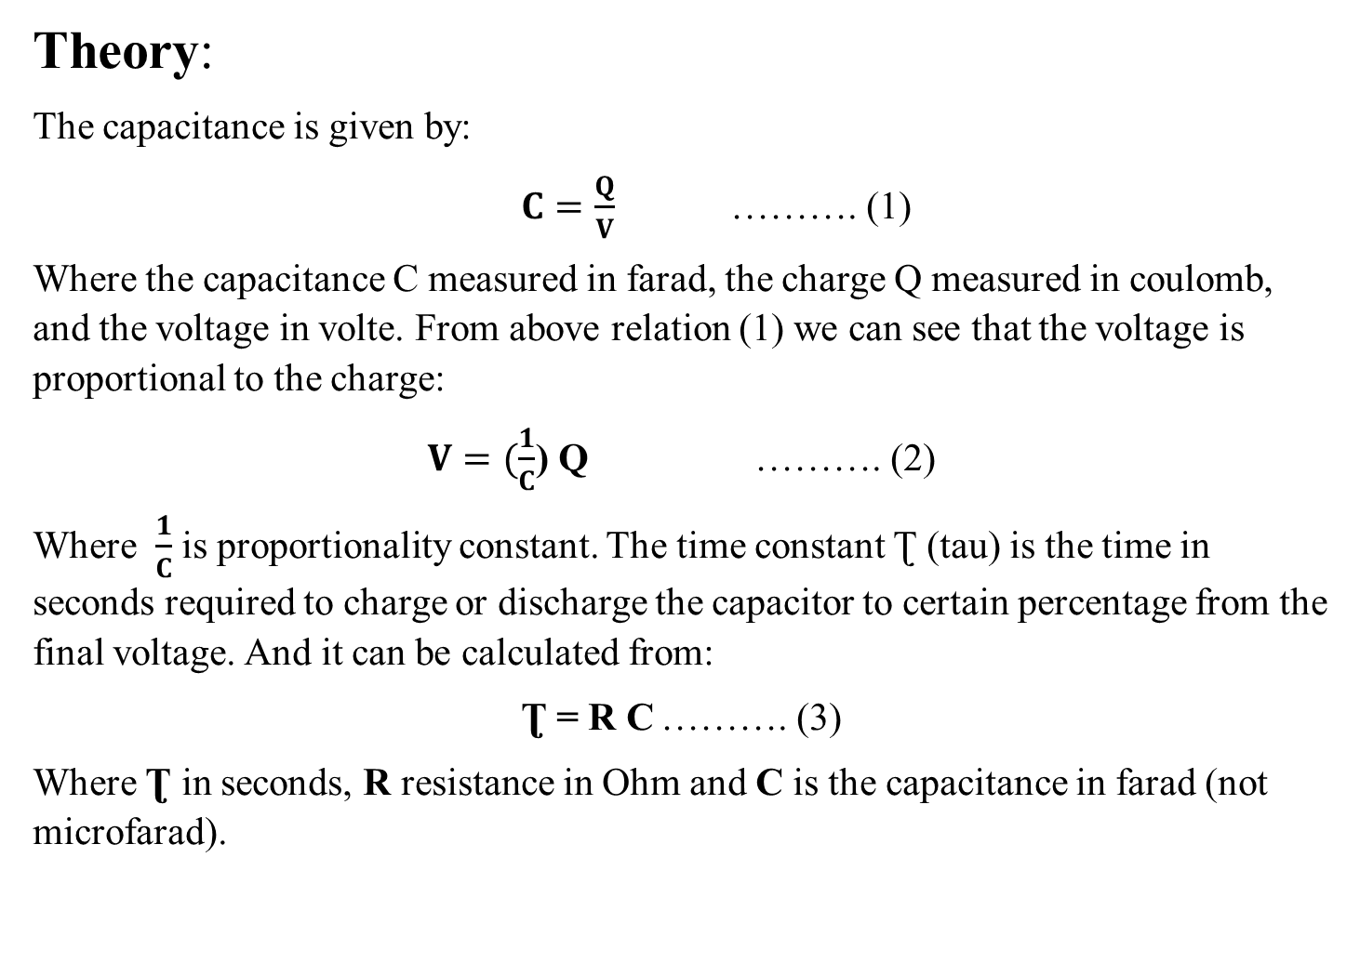
Theory:
The capacitance is given by:
$C=\frac{Q}{V}$ ………. (1)
Where the capacitance C measured in farad, the charge Q measured in coulomb, and the voltage in volte. From above relation (1) we can see that the voltage is proportional to the charge:
$V=(\frac{1}{C}$) Q ………. (2)
Where $\frac{1}{C}$ is proportionality constant. The time constant Ʈ (tau) is the time in seconds required to charge or discharge the capacitor to certain percentage from the final voltage. And it can be calculated from:
Ʈ = R C ………. (3)
Where Ʈ in seconds, R resistance in Ohm and C is the capacitance in farad (not microfarad).

Slide 5
Instruments:
DC power supply.
Capacitor.
Voltmeter.
Timer.
Connection wires.

Slide 6
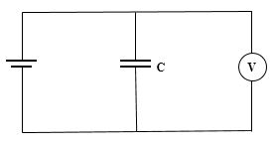
Methods:
Connect the circuit as shown in figure (1).
Charge the capacitor until it reach V_{o} which is the highest value reached by voltmeter, record V_{o} value.
Disconnect one of wires from source for discharge, record the time.
Figure 1. Experiment circuit.

Slide 7
.
Repeat step (2, 3) for different voltage with recording the time for each.
Write down your reading in below table:
V (volt) | V_{o} | V_{o}-1 | V_{o}-2 | V_{o}-3 | V_{o}-4 | V_{o}-5 | V_{o}-6
t (sec)

